Slide 1
HF Digital Modes, Including FT-8
Neil Goldstein, W2NDG

Slide 2
Digital Modes
What is a digital mode?
We’re referring to digital text modes for the purposes of this discussion
An Amateur digital mode is a radio mode where characters are sent by a chosen form of modulation and encoded using an open code (not encrypted for security)
Most of these can be heard as tones, blips, musical notes, or organized noise
Technically, CW is a digital mode

Slide 3
Digital Modes
CW, RTTY
PSK31 (and other PSK derivatives)
Olivia, Contestia, Domino
Hellschreiber (or Hell)
Packet, MT63
JT65, FT8, FT4, JS8
WSPR (not really a QSO mode)
Pictures too
WeFAX and SSTV

Slide 4
Software
FLDIGI
WSJT-X
JS8-CALL
Ham Radio Deluxe – DM780
WinLink
Others: MixW, MultiPSK, JTDX, MSHV
We’re going to discuss WSJT-X mostly

Slide 5
Joe Taylor (Joseph Hooton Taylor Jr.)
That’s what the “JT” in WSJT stands for
As well as the “T” in FT8
Joe is an Astrophysicist and won a Nobel Prize for his work with pulsars
Lucky for us, he’s also interested in Ham Radio, and goes by K1JT
It’s Joe’s interests in weak signal communications that brought us these wonderful modes and applications

Slide 6
WSJT-X Uses
Weak signal communications:
Moon Bounce (EME)
Meteor Scatter
Propagation Reporting
And.. Digital QSOs (unintentional at first)
Modes (HF)
JT9, JT65, FT8 & FT4 for QSO’s
WSPR (which is a non QSO mode)

Slide 7
JT65
Originally intended for EME and other similar conditions, Hams started using JT65 on the HF bands. Several features were added to facilitate HF use.
Signals are sent with FEC (forward error correction) and are capable of being decoded when being below the noise floor. Each signal uses 65 tones, and is just under 180 hz wide.
Each part of a JT65 exchange takes one minute.

Slide 8
Timing
Getting this to work (JT65 or FT8) requires things to be time synchronized. Everyone needs to be transmitting or receiving at exactly the same interval.
There are a few seconds included as a buffer, but your computer’s clock needs to be EXACT.
You should install software to assist with the clock setting, otherwise you will need to manually synchronize often.

Slide 9
Time Sync Software
On Windows:
Meinberg NTP. Instructions at the WSJT-X site
On Apple OS/X:
You can change your time sync settings in System Preferences
On Linux:
Out of the box settings may be OK, but if not you may need to choose a different time server, and update interval. Google is your friend!

Slide 10
Typical Exchange
CQ K1ABC FN42 #K1ABC calls CQ
K1ABC G0XYZ IO91 #G0XYZ answers
G0XYZ K1ABC –19 #K1ABC sends report
K1ABC G0XYZ R-22 #G0XYZ sends R+report
G0XYZ K1ABC RRR #K1ABC sends RRR
K1ABC G0XYZ 73 #G0XYZ sends 73

Slide 11
“The “A” Word
A small amount of automation is present
Once you “jump” on a signal, the major steps can be automatic
If choose to call CQ first, the process is even more automatic once someone responds.
Any more automation than that is not discussed here.

Slide 12
Power
Yes, JT-65 was originally thought of as a low power mode, but not for the reasons you think. Duty cycle made it that way. Running your transmitter flat out on MFSK for 50 seconds straight is not a great thing. FT8 fixes this, as well as speeding things up just to dial back the boredom involved with 6 x 60 second portions of a full exchange

Slide 13
Enter: FT8
FT8 was developed jointly by Joe Taylor and Steve Franke (K9AN).
Same basic features and rules as JT65, but the interval drops from 60 seconds to 15 seconds. Timing is now MORE IMPORTANT!
The original idea was a mode for multi-hop Es where signals may be more prone to fading. JT65 fans had other plans though

Slide 14
FT8 Technical Info
Eight tone MFSK
47hz Bandwidth
Decoding threshold = -20db
Decodes all signals in the passband
Speed Speed Speed

Slide 15
Where do I get it?
https://physics.princeton.edu/pulsar/k1jt/wsjtx.html
But wait…. Stop trying to write this down.
Just GOOGLE IT!
Google: WSJT-X

Slide 16
Keep your installs up to date! Changes sometimes occur that will leave you behind.
Windows
Runs on Windows XP, 7, 8, 10 both 32 and 64
Linux
Builds for
Debian based distros (.deb)
RedHat based distros (.rpm)
Raspbian on Raspberry Pi
Mac OS/X
10.7 and later (read the readme file!!)

Slide 17
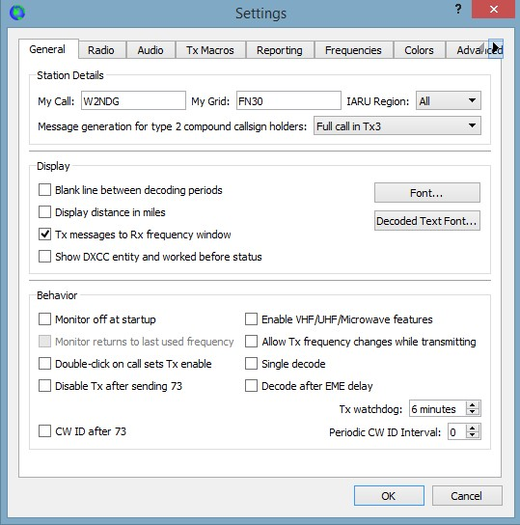
Easy setup (Except on MacOS)

Slide 18
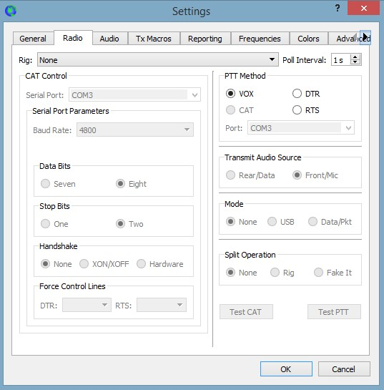
Setup Continued…

Slide 19
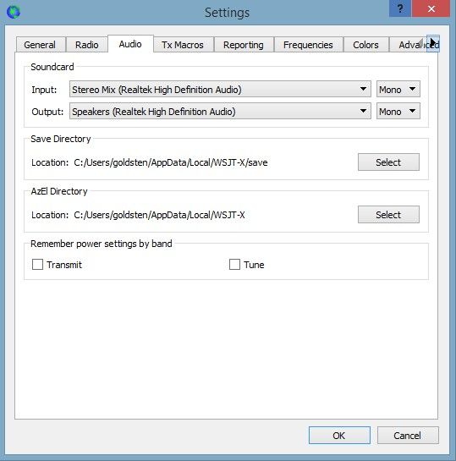
Setup Continued…

Slide 20
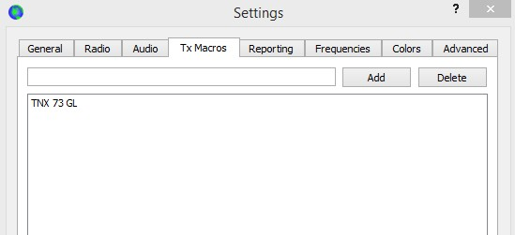
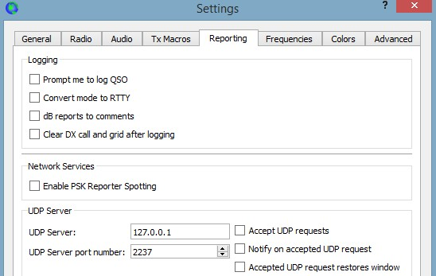
Setup Continued…

Slide 21
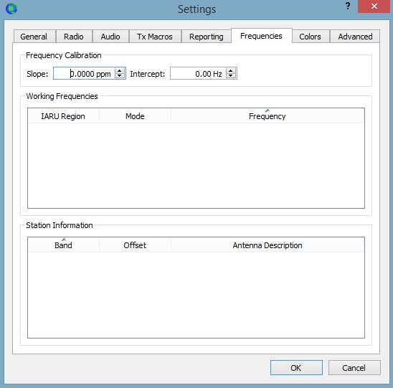
Setup Continued…

Slide 22
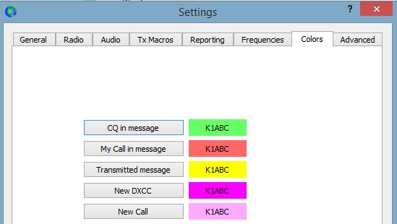
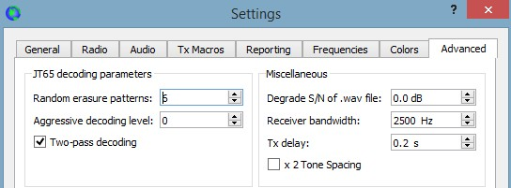
Setup Continued…

Slide 23
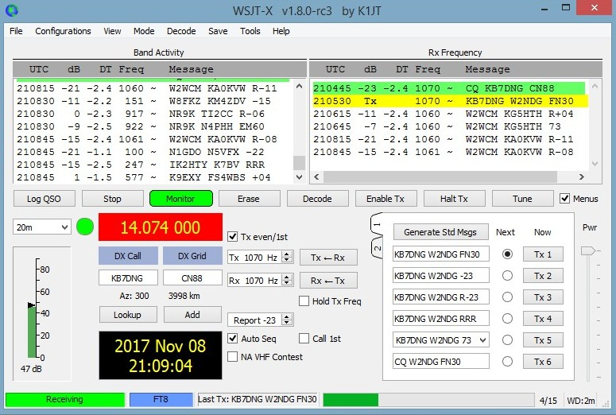
Main Window

Slide 24
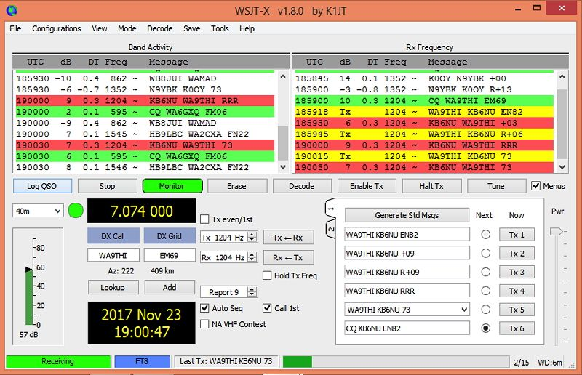
Main Window
The left window shows band activity. Green means someone sending CQ, while Red are transmissions directed at you.
Right window shows activity on the receive frequency and your transmissions (Yellow).
Double clicking on a green CQ starts the process. You have to be quick!
If you miss, you will re-transmit the response in the next transmit cycle
You can edit the exchanges. Most people leave them defaulted.

Slide 25
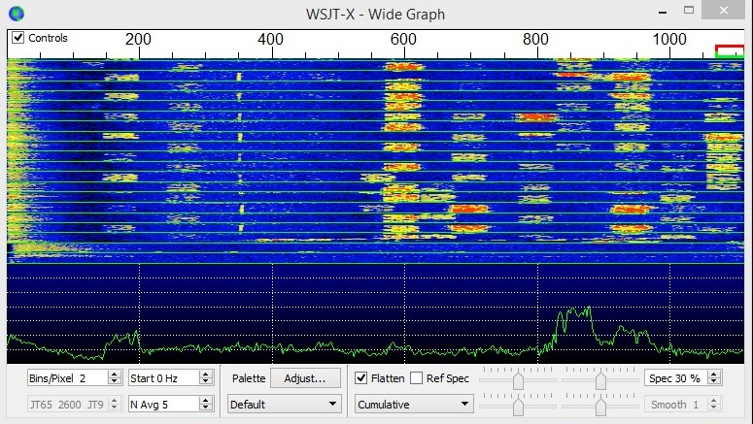
“Wide Graph” (Waterfall)

Slide 26
“Wide Graph” (Waterfall)
Clicking on the waterfall changes receive frequency
Control-click changes transmit frequency

Slide 27
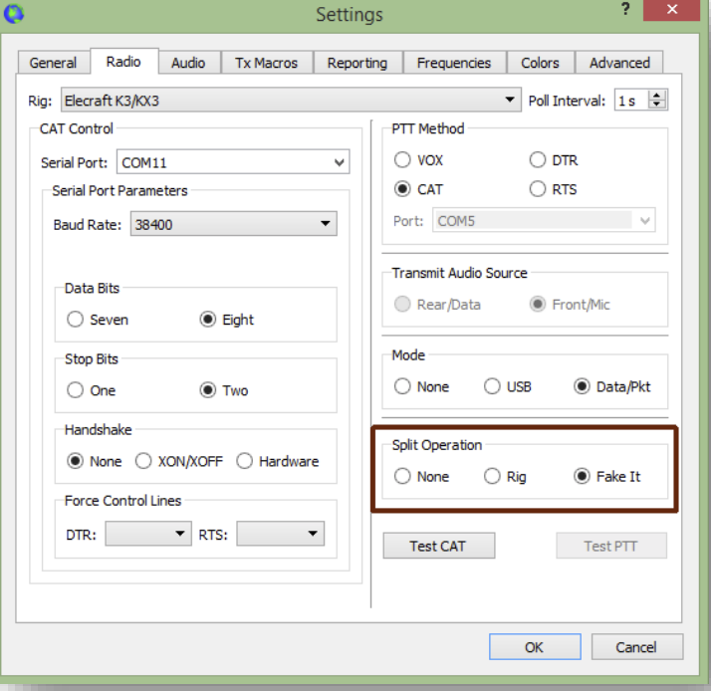
Split Mode
Significant advantages result from using Split mode (separate VFOs for Rx and Tx) if your radio supports it. If it does not, WSJT-X can emulate such behavior. Either method will result in a cleaner transmitted signal, by keeping the Tx audio always in the range 1500 to 2000 Hz so that audio harmonics cannot pass through the Tx sideband filter. Select Rig to use the radio’s Split mode, or Fake It to have WSJT-X adjust the VFO frequency as needed, when T/R switching occurs. Choose None if you do not wish to use split operation. – WSJT-X Manual

Slide 28
Contest Mode
A special NA VHF Contest mode can be activated for FT8 and MSK144 modes by checking a box on the main window. This mode is configured especially for contests in which four-character grid locators are the required exchange. When NA VHF Contest mode is active, the standard QSO sequence looks like this:
CQ K1ABC FN42
K1ABC W9XYZ EN37
W9XYZ K1ABC R FN42
K1ABC W9XYZ RRR
W9XYZ K1ABC 73

Slide 29
Add On
JTAlert from hamapps.com

Slide 30
FT8 Guide by ZL2IFB
https://www.g4ifb.com/FT8_Hinson_tips_for_HF_DXers.pdf
This is all you need really. We could spend way too much time here talking about details. Just read this guide!!

Slide 31
FT4 Mode – What is it?
Mode for contesting
4 FSK tones spaced ~20 Hz apart instead of 8 tones ~6 Hz apart, hence FT4 vs. FT8
7.5 Sec. transmissions – half the time
WSJT-X modes are becoming more prevalent in contests. FT4 allows more QSOs in the same amount of time

Slide 32
JS8Call – What is it?
Designed by Jordan Sherer, KN4CRD
Jordan Sherer Designed MSK-8 : JS8
Originally known as FT8Call
Applying a conversational mode to the FT8 principle. Conversations occur at approximately 5 - 15 words per minute
User guide here: https://tinyurl.com/yc6z73do

Slide 33
JS8Call
Newer versions support 4 speeds
Slow, Normal, Fast, and Turbo
30, 15, 10, and 6 second frames
Faster computers can decode all 4 at once
The idea otherwise is to start in NORMAL and move to a faster mode (or slower) depending on conditions

Slide 34
JS8Call
Three types of messages
Standard
Similar to PSK31. Keyboard to keyboard
Only works if you are 10Hz apart
Undirected
For CQ mostly
Directed
To specific call or @ALLCALL or a group call

Slide 35
JS8Call Main Screen

Slide 36
New FT8 Radio Kits
D4D DSB Transceiver Kit
From CRKits.com
DSB Digital Transceiver Kit
From QRPguys.com
K1SWL’s Phaser Digital Mode SSB Kit
From midnightdesignsolutions.com
Digital 40 SSB Transceiver Kit or Assembled
From youkits.com No manual yet - NEW

Slide 37
DSB Controversy
Second signal is transmitted in LSB
For example: when transmitting on 20M LSB signal will appear in the 20M PSK sub-band. Not illegal as such, but could be annoying.
At 1 Watt (500 mw actually) may not be a huge issue, but….
Two DSB transceivers are unable to communicate

Slide 38
Portable Setup
Use a Raspberry Pi with LCD screen
Completely portable Digital mode rig
Just needs battery power (12V and 5V)
Remote operation: PC and Internet with remote desktop or other remote software like TeamViewer, or RDP

Slide 39
D4D From CR Kits
DSB (controversial)
Available for FT8 80, 40, and 20 M
Available for JS8Call 30 M
$39 Plus shipping from CRKits
About 1 Watt
Here’s the one I built:

Slide 40
D4D From CR Kits

Slide 41
D4D From CR Kits

Slide 42
D4D From CR Kits

Slide 43
DSB Digital Transceiver Kit From QRPguys.com
DSB (controversial)
Available for FT8 40, 30, and 20 M
Additional blank band modules available
$40 Plus shipping from QRPguys
2.5 watts on 40m, over 1.5 watts on 30m, and over 1 watt on 20m
Here’s the one I built:

Slide 44
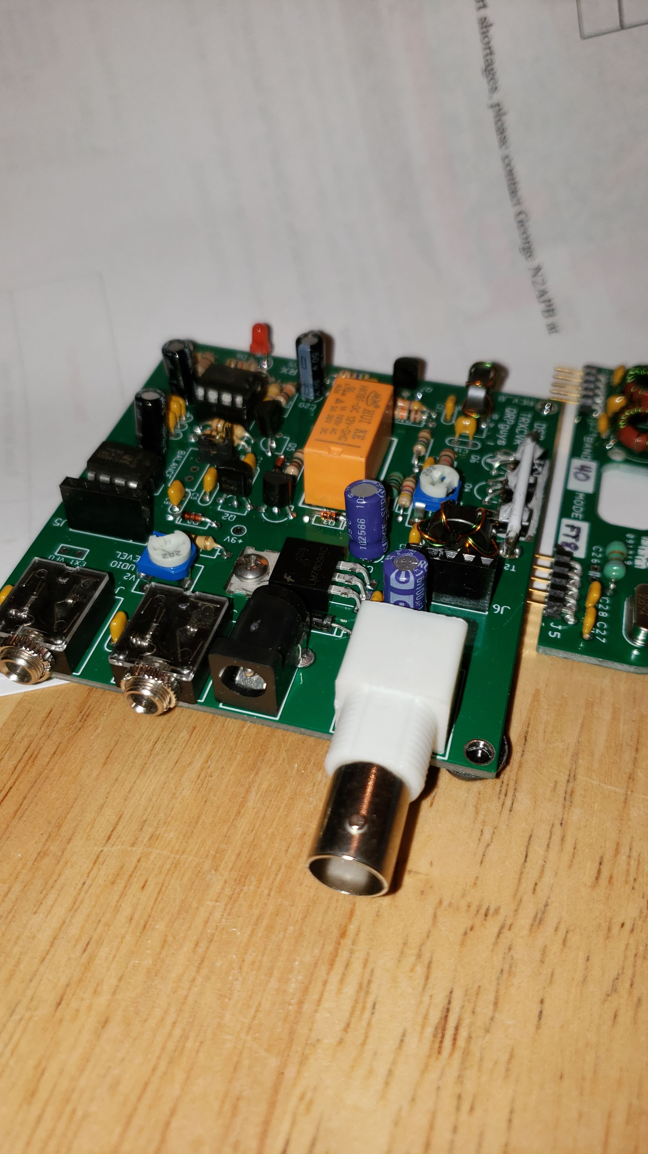
DSB Digital Transceiver Kit From QRPguys.com

Slide 45
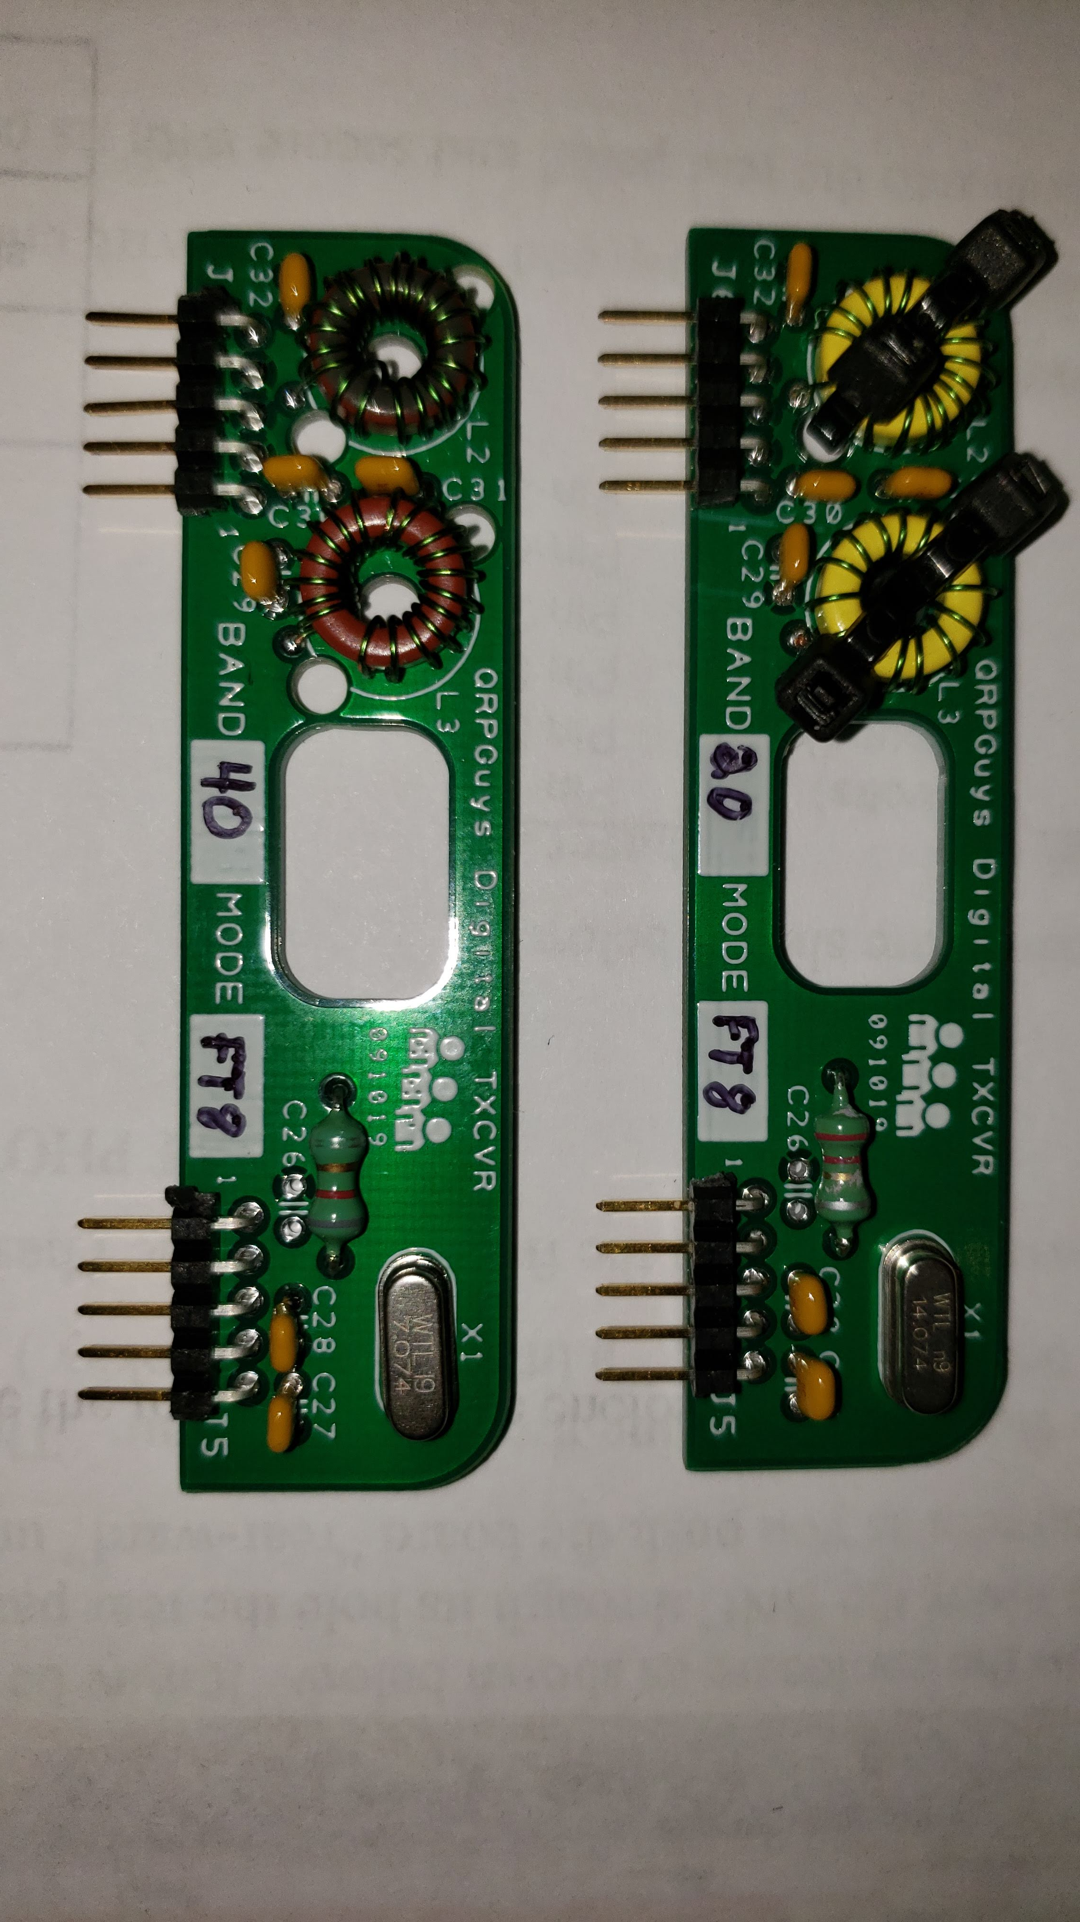
DSB Digital Transceiver Kit From QRPguys.com

Slide 46
K1SWL’s Phaser from Midnight Design Solutions
SSB (not controversial !!)
Available for FT8 80, 40, 30, and 20 M
Additional frequency within chosen band can be programmed
$55 Plus shipping from MDS
$25 for custom enclosure
4 Watts SSB
Designed by Dave Benson K1SWL !!
Here’s the one I built:

Slide 47
K1SWL’s Phaser from Midnight Design Solutions

Slide 48
K1SWL’s Phaser from Midnight Design Solutions

Slide 49
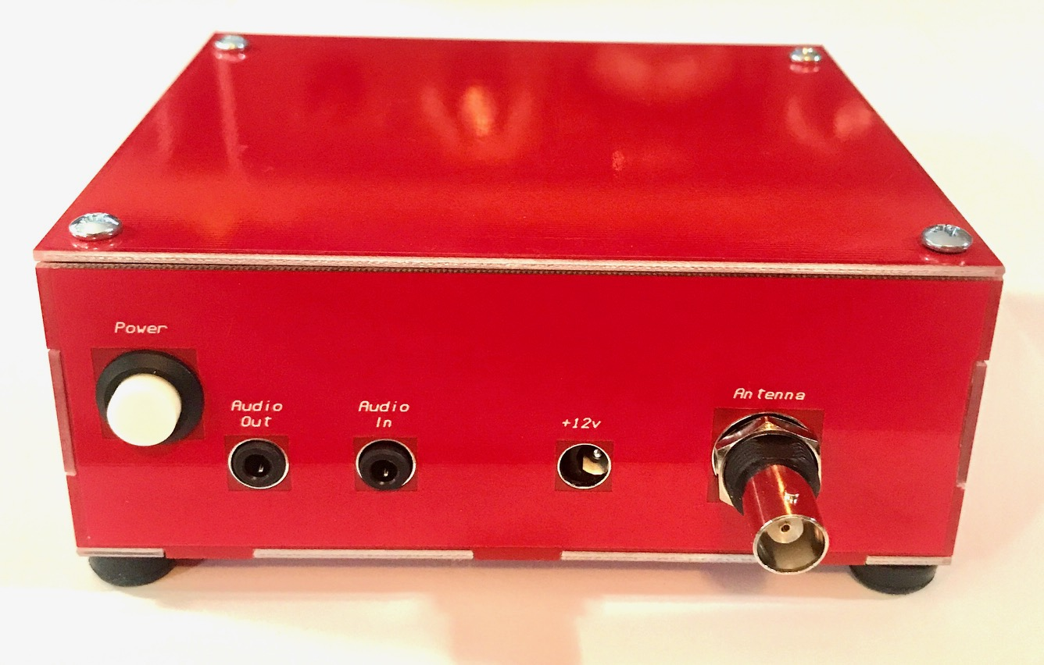
K1SWL’s Phaser from Midnight Design Solutions

Slide 50
K1SWL’s Phaser from Midnight Design Solutions

Slide 51
Digital 40 SSB Transceiver Kit from YouKits.com
SSB (not controversial !!)
Available for 40 M
Multi-Frequency (so, multi mode)
$99 Plus shipping from YouKits
$149 assembled
4-5 Watts SSB
No manual yet
Not sure if kit includes case

Slide 52
Have Fun!
Ignore the trolls!
All links and this presentation can be found at:
FOFIO.BLOGSPOT.COM

