Slide 1
An introduction to
Raspberry Pi
Neil Goldstein – W2NDG
HRU 2021
Notes:
This presentation demonstrates the new capabilities of PowerPoint and it is best viewed in Slide Show. These slides are designed to give you great ideas for the presentations you’ll create in PowerPoint 2010!
For more sample templates, click the File tab, and then on the New tab, click Sample Templates.

Slide 2
Audience Poll
Do you already own a Pi? (Yes/No)
How many do you own? (1, 2, 3 or more)
Do you already use it for Ham radio? (Yes/No)
Have you used it as a regular desktop? (Yes/No)
Do you own another SOC board computer? (Yes/No)
Already own a Pi 4? (Yes/No)
Already own a Pi 400 (Yes/No)

Slide 3

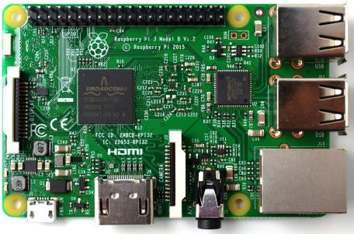
Overview
What is it?
  What isn’t it?
SOC (Broadcomm)
RISC vs CISC
History and models
Layout and features
What can I do with it?
  Ham radio apps

Slide 4


The Raspberry Pi, is simply, a computer.
A small, inexpensive computer.
It has the same components of a larger system, or equivalents. Input-Output, Memory, Storage, Audio, Video, and more.
What is it?

Slide 5
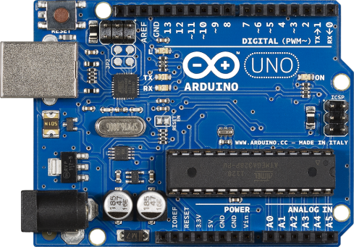
The Raspberry Pi is not the same thing as an Arduino board, or other microcontroller specific systems.
What isn’t it?
It does have a GPIO bus for performing many Arduino-like functions, so in some ways it’s the best of both worlds

Slide 6

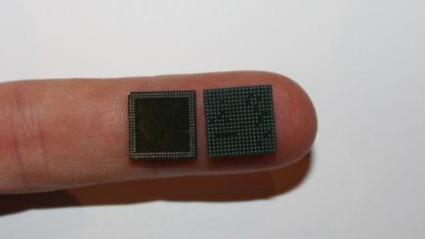
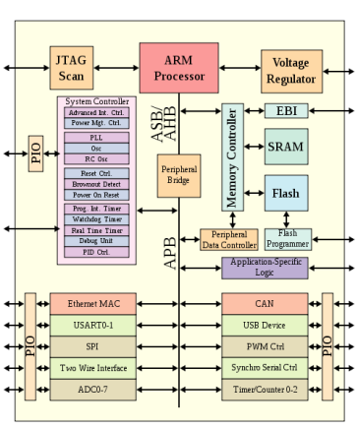
SOC (System On a Chip)
Integrates many components that are usually separate from the CPU into ONE PACKAGE.
Used in many compact, and appliance-like products. Your phone has a SOC. Low-end laptops like a ChromeBook have a SOC.

Slide 7


Some RISC-based Products:
iPhone
Android Phones
Raspberry Pi
PlayStation 3 CELL Processor
PowerPC
RISC vs CISC
RISC stands for Reduced Instruction Set Computing. As compared to CISC (Complex..) It is more efficient. A 1GHz RISC is much more capable than a 1GHz INTEL Pentium
This is why when you look at ARM processors like the ARM Cortex-A53 in the current Pi 3 you cannot compare apples to apples with speed, and RAM.

Slide 8
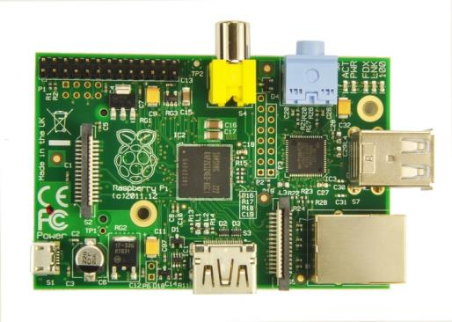
Released to the public in February 2012
Main goals were accessibility and education
Much like the BBC MICRO computer from ACORN in Britain in the Eighties
History
Insanely popular at first. Supply was tight.
There have been several major revisions since release.
Original Pi Model B

Slide 9
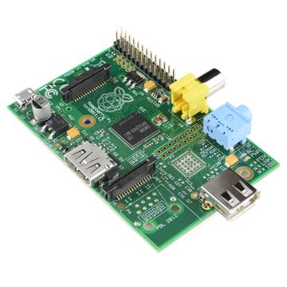
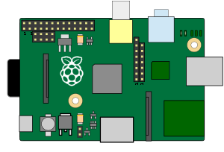
700 MHz Single Core
256 M RAM
1 USB Port
NO Ethernet
HDMI
Composite
Analog Audio
SD Card (Full)
Raspberry Pi (1)
Model A
Models : Original
Original Pi Model A
Others: -Newer Model A
-Compute Board

Slide 10
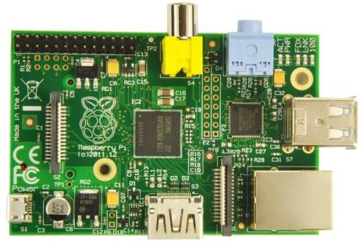
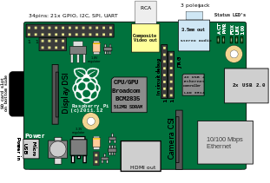
700 MHz Single Core
512 M RAM
(256 early models)
2 USB Ports
Ethernet
HDMI
Composite
Analog Audio
SD Card (Full)
Raspberry Pi (1)
Model B
Models : Original
Original Pi Model B

Slide 11
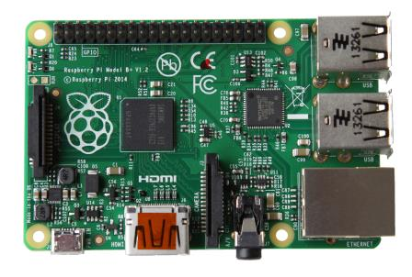
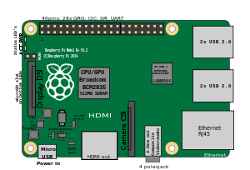
700 MHz Single Core
512 M RAM
4 USB Ports
Ethernet
HDMI
Composite
Analog Audio
(Composite and Audio integrated in one jack)
SD Card (Micro)
Raspberry Pi (1)
Model B+
Models : Original PLUS
Pi Model B+

Slide 12
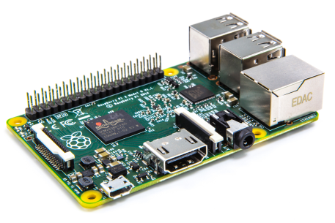
900 MHz Quad Core
1 GB RAM
4 USB Ports
Ethernet
HDMI
Composite
Analog Audio
(Composite and Audio integrated in one jack)
SD Card (Micro)
More GPIO Pins
Raspberry Pi 2
Model B
Models : Pi 2
Pi 2 Model B

Slide 13

1.2 GHz Quad Core
(64 Bit)
1 GB RAM
4 USB Ports
Ethernet
HDMI
Composite
Analog Audio
WiFi
Bluetooth
(Composite and Audio integrated in one jack)
SD Card (Micro)
Raspberry Pi 3
Model B
Models : Pi 3
Pi 3 Model B

Slide 14
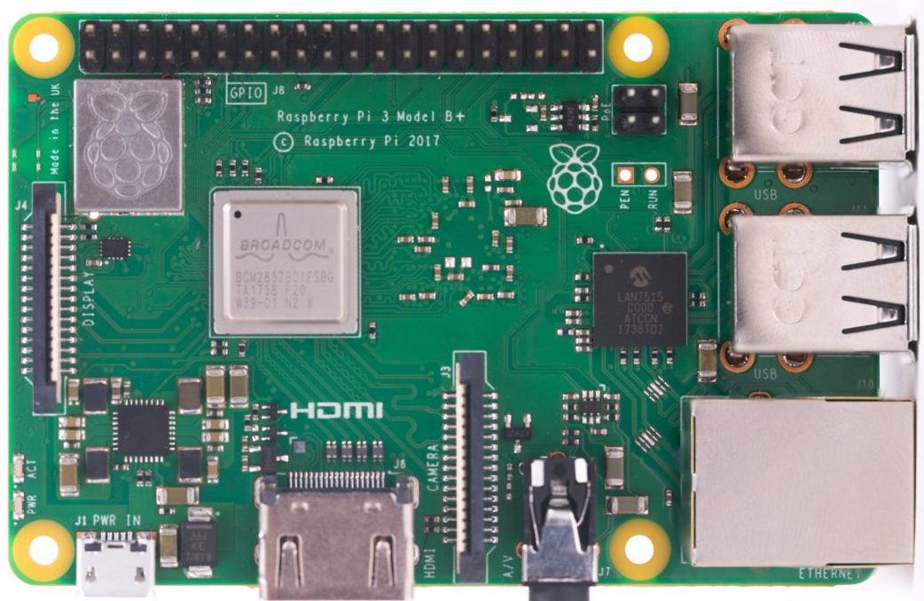
1.4 GHz Quad Core
(64 Bit)
1 GB RAM
4 USB Ports
Ethernet
HDMI
Composite
Analog Audio
WiFi (Dual Band)
Bluetooth (Updated)
(Composite and Audio integrated in one jack)
SD Card (Micro)
POE
Raspberry Pi 3
Model B+
Models : Pi 3
Pi 3 Model B

Slide 15
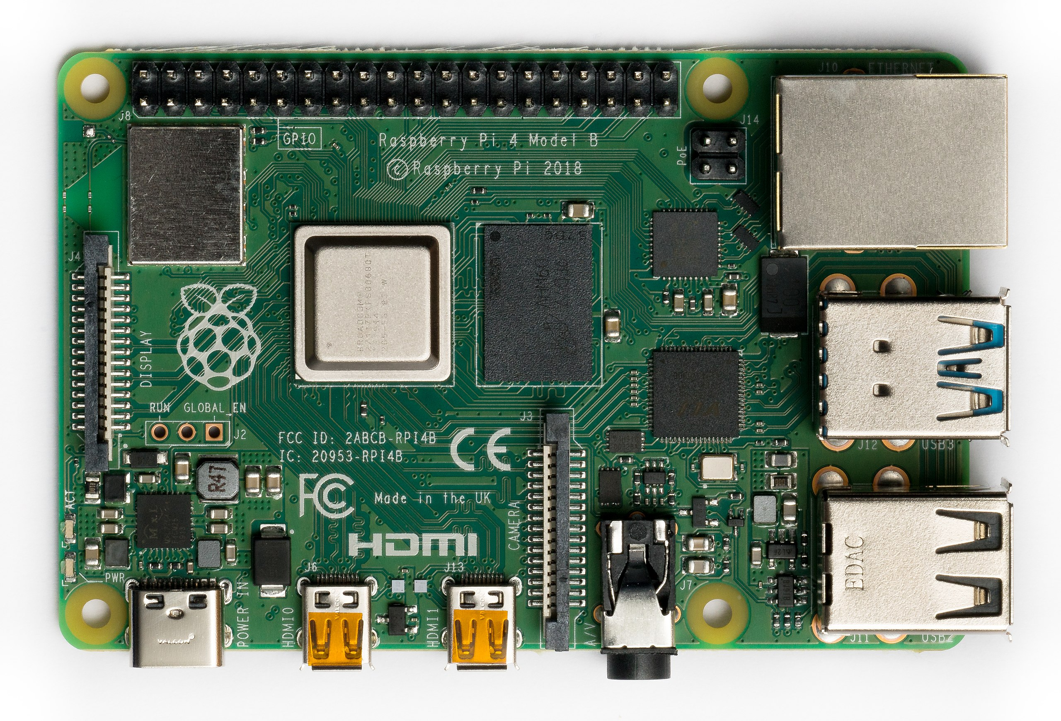
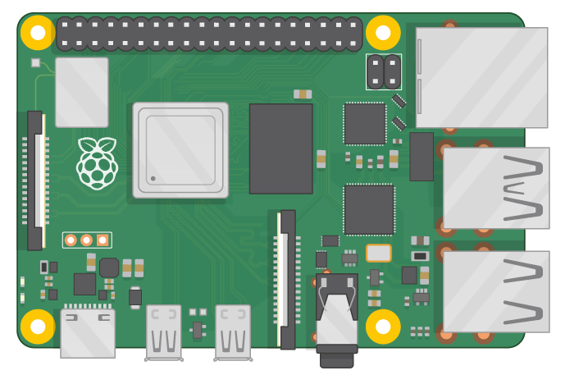
1.5 GHz Quad Core
(64 Bit) ARM V8
2, 4, or 8 GB RAM
2 USB2 Ports 2 USB3
Gigabit Ethernet
2 X Micro HDMI
Composite
Analog Audio
WiFi (Dual Band)
Bluetooth (Updated)
(Composite and Audio integrated in one jack)
SD Card (Micro)
POE
USB C Power
Raspberry Pi 4
Model B
Models : Pi 4
Pi 4 Model B

Slide 16
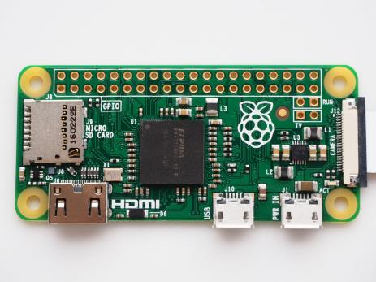
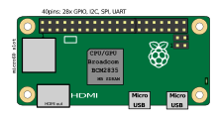
1 GHz Single Core
512 M RAM
1 Micro USB Port
(needs OTG Adapter)
Mini HDMI
Analog Audio (through GPIO)
SD Card (Micro)
TINY – and $5
Raspberry Pi Zero
Models : Pi ZERO
Pi Zero

Slide 17
1 GHz Single Core
512 M RAM
1 Micro USB Port
(needs OTG Adapter)
Mini HDMI
Analog Audio (through GPIO)
SD Card (Micro)
Wifi
Bluetooth
TINY – and $5
Raspberry Pi Zero W
Models : Pi ZEROW
Pi Zero

Slide 18
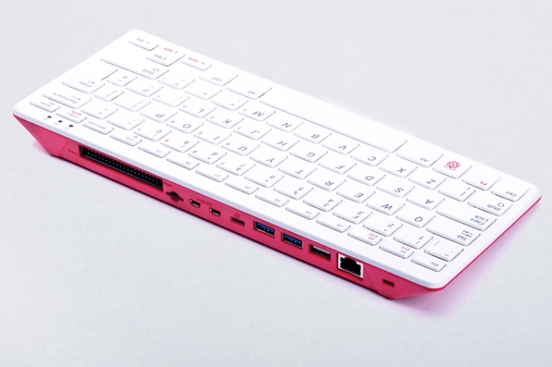
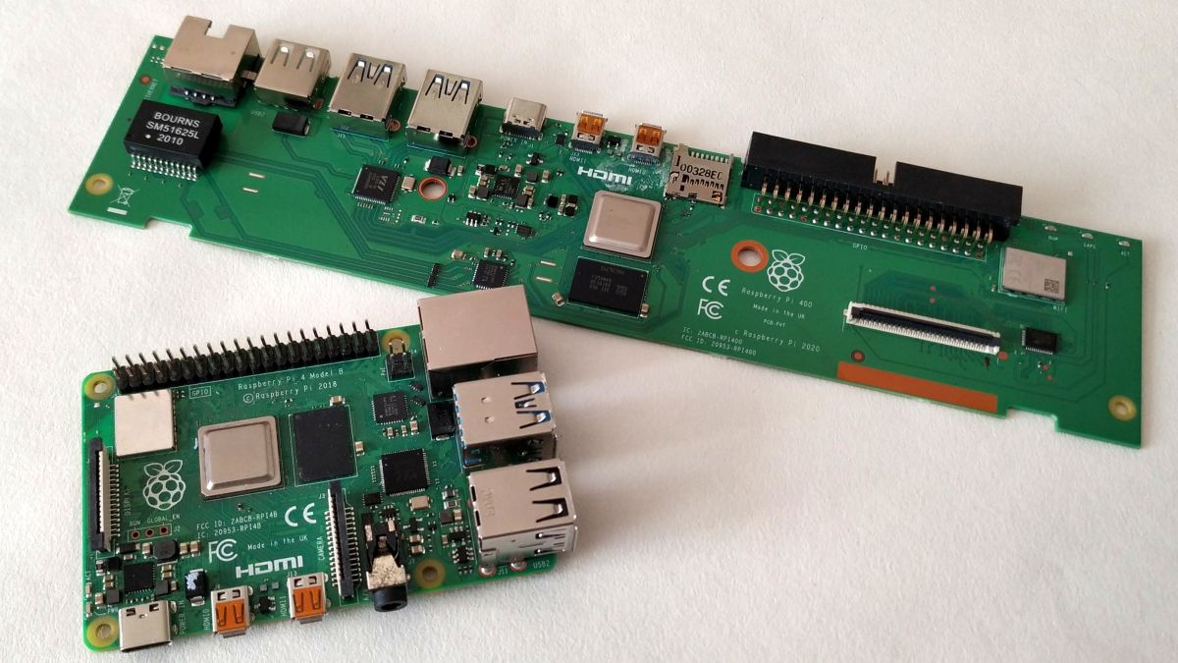
1.8 GHz Quad Core
(64 Bit) ARM V8
4 GB RAM
2 USB2 Ports 2 USB3
Gigabit Ethernet
2 X Micro HDMI
WiFi (Dual Band)
Bluetooth (Updated)
No composite or audio jack
SD Card (Micro)
POE
USB C Power
Horizontal GPIO
Built-In Keyboard
Cooling (improved)
Raspberry Pi 400
Models : Pi ZEROW
Pi 400 vs Pi 4

Slide 19
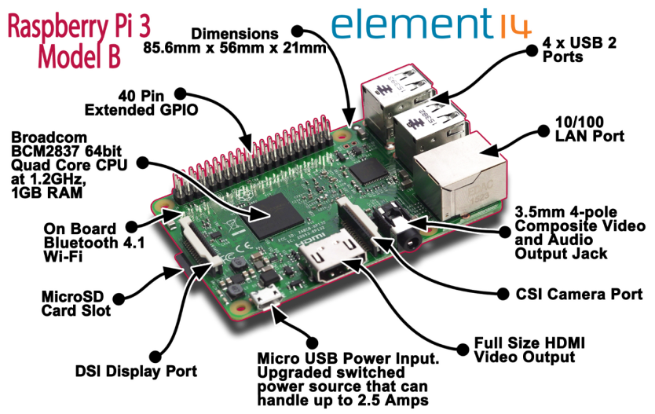
RaspberryPi 3 Layout
Layout : Previous Model

Slide 20
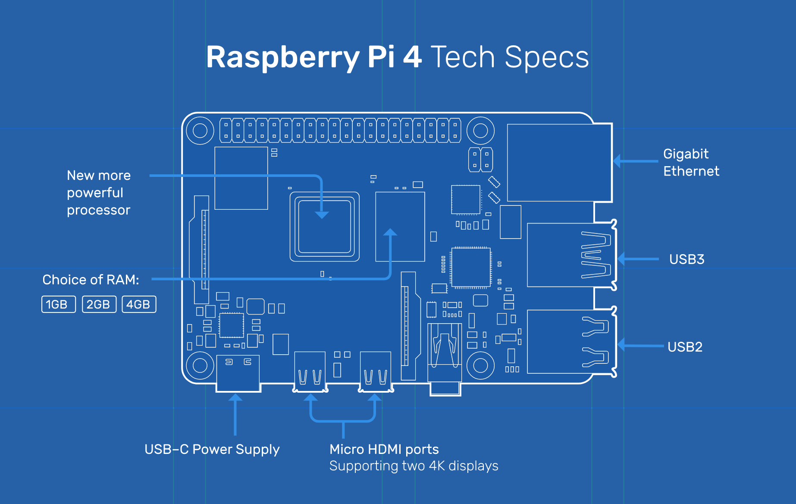
RaspberryPi 4 Layout Changes
New Form Factor (new cases required)
Layout : Current Model

Slide 21
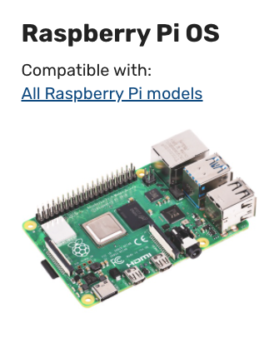
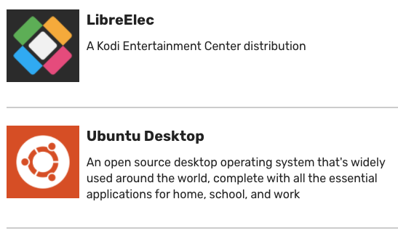
OFFICIAL OPERATING SYSTEM IMAGES
Operating Systems

Slide 22
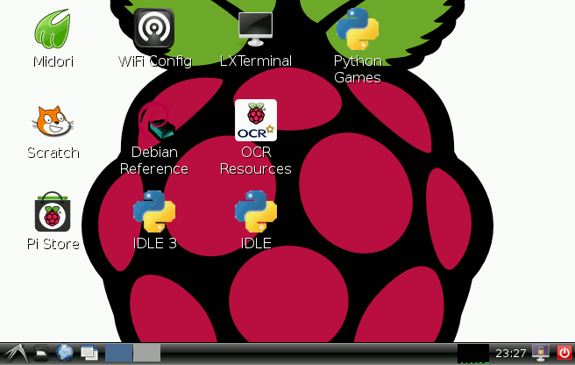
What about Windows??
I thought I saw Windows in that list!!
Originally we saw the IOT version of Windows for Pi. That seems to no longer be around, but several users have managed to hack the ARM version of Windows 10 to run on a Pi.
And Android?
Not at this time. Broadcom has not opened up Android support for it’s SOC used in the Pi. Some of the Pi alternatives support it.
What are the limitations?
As mentioned before, because of the Pi’s ARM architecture, only programs compiled to run in an ARM environment are available. Not everything compiles well for ARM, but there are lots of choices.
In particular, the WINE layer for running Windows programs will not work. At least not directly. There have been attempts to make an X86 emulation layer for the Pi, but so far they have not been very successful.

Slide 23
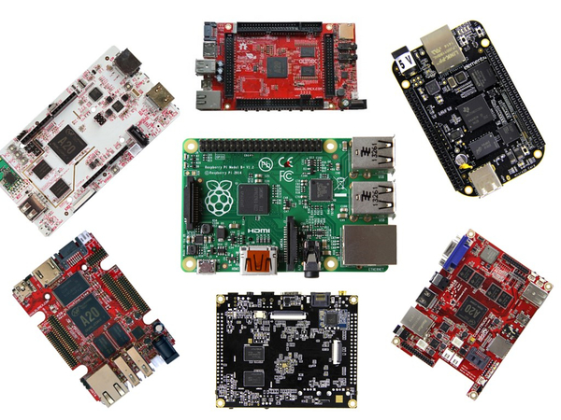
Stability
We don’t see the Raspberry Pi project disappearing any time soon. Some of the others already have. CHIP being the most visible failure. There are SO MANY. Just Google: Alternatives to Raspberry Pi
Support
You can’t beat the popularity of the Pi. It might not be the most powerful choice for a specific task, but the community support is endless, as well as the huge choice in add-ons and accessories.
The Other Contenders
Frequently I hear that the Cranberry Deluxe Mini, or <insert generic name here> is so much better than the Raspberry Pi from people. There are definitely applications where there are viable alternatives. A great example being the KiwiSDR project which relies on one of the Beagle Boards. Or the Latte Panda which runs REAL Windows, but costs quite a bit more, and you may not want to run Windows.

Slide 24
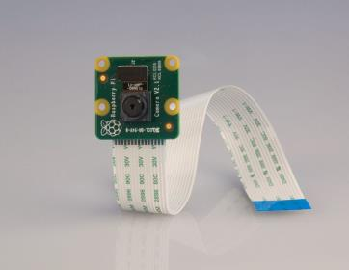
Small Desktop Computer
Media Center
Music Player
Weather Station
Robotics
Web Enabled Controller
Education
Remote Camera
Terminal – Thin Client
Gaming
Kiosks
Small Servers
Ham Radio
What Can I Do With it?
It’s basically a computer, and will do almost anything that a computer would do.
It won’t be as fast as a modern desktop, although the Model 4 is pretty quick, especially the 4GB version. Finally approaching usable desktop speed
You have the addition of the GPIO bus for controlling and sensing the world around you

Slide 25
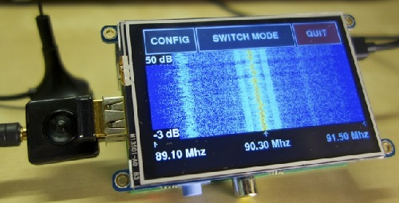
ADS-B Airplane Tracking
Remote SDR Server
SDR Radio (Pi 3 & 4 Only)
Digital Radio Hotspot
Echolink node
APRS
WSPR
Antenna and Rotator Control
TNC
Spectrum Monitor
PSK31 Terminal (and others)
Rig Control (RigPi)
Transmitter (more on that….)
Ham Radio Uses
For now, we are limited to LINUX programs that run on ARM processors. That’s FLDIGI and few rig control apps, as well as some SDR applications. There are also linking, APRS, and Packet applications.

Slide 26
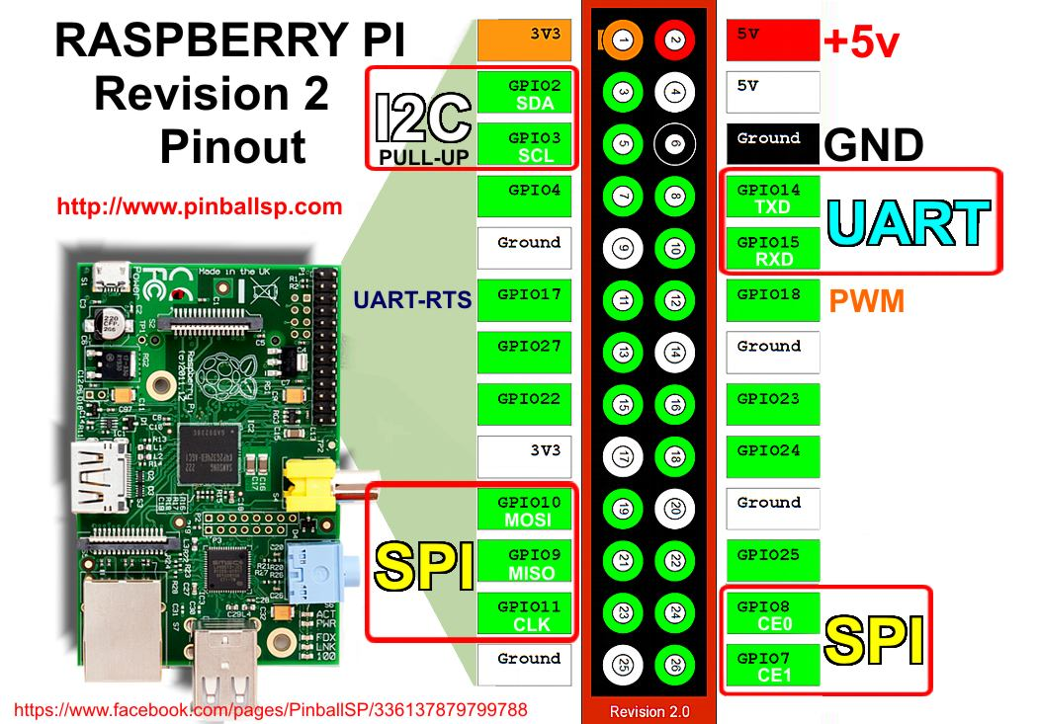
GPIO Pins can be modulated at a high enough frequency to transmit RF
Transmitting Directly from Pi

Slide 27
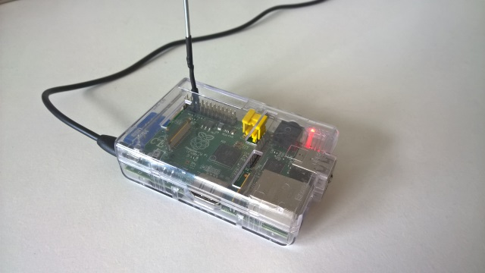
The Pi FM Project originally demonstrated this by transmitting music over FM stereo.
Later, others modified the theory to get AM, FM, SSB, and digital modes.
The output is not very clean and obviously very low power.
There are projects to make all kinds of transmitters which work as long as you filter the output, including low power fox hunt transmitters.
Transmitting Directly from Pi

Slide 28
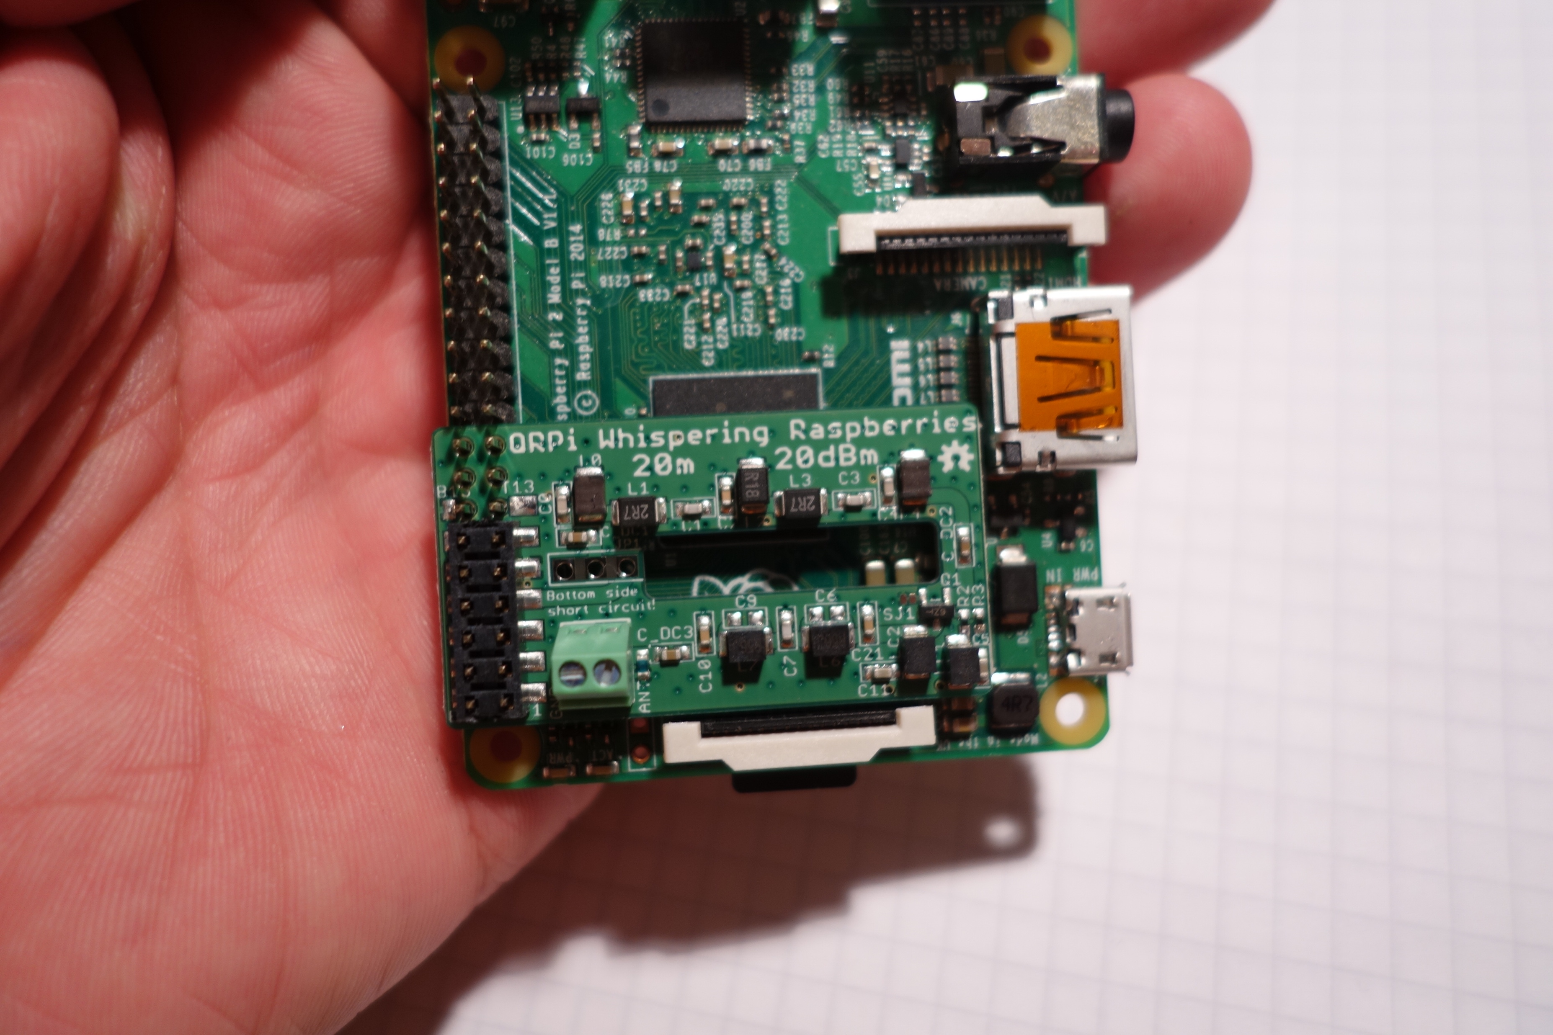
WSPR Pi is a project from TAPR (Tucson Amateur Packet Radio). It combines the filters and amplifier needed to clean up an HF signal into a neat little board.
There’s a way to create a transceiver using this board (with some minor changes) and a RTL-SDR dongle in either direct-sampling mode or with an upconverter. You’ll probably want an amp too. GTCSDR
Transmitting Directly from Pi
Amateur

Slide 29
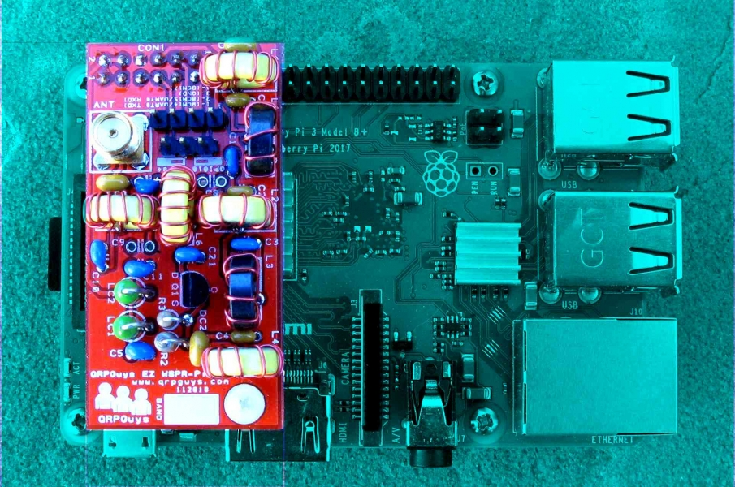
A kit version is available from QRPguys.com for $20. Board Only for $10
Transmitting Directly from Pi

Slide 30
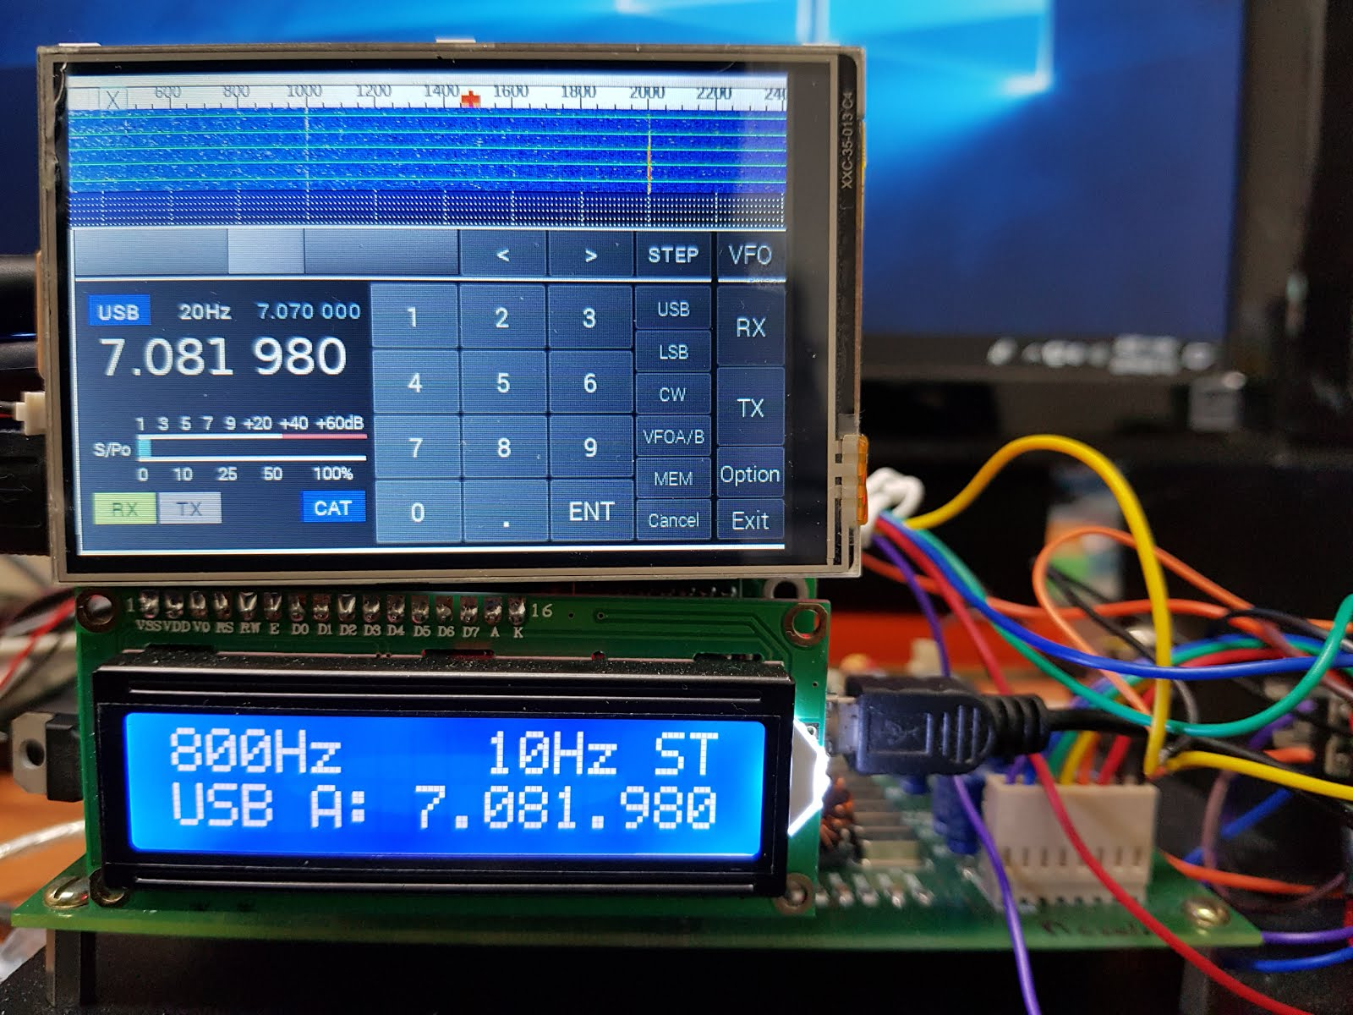
Ian Lee, KD8CEC, Has a great website for support of the uBITX transceiver. One of his projects was to combine a Ras-Pi with a uBITX for a self-contained digital mode transceiver.
http://www.hamskey.com/2018/02/raspberry-pi-mod-for-wsjtx-portable.html
Digital Modes Embedded XCVR

Slide 31
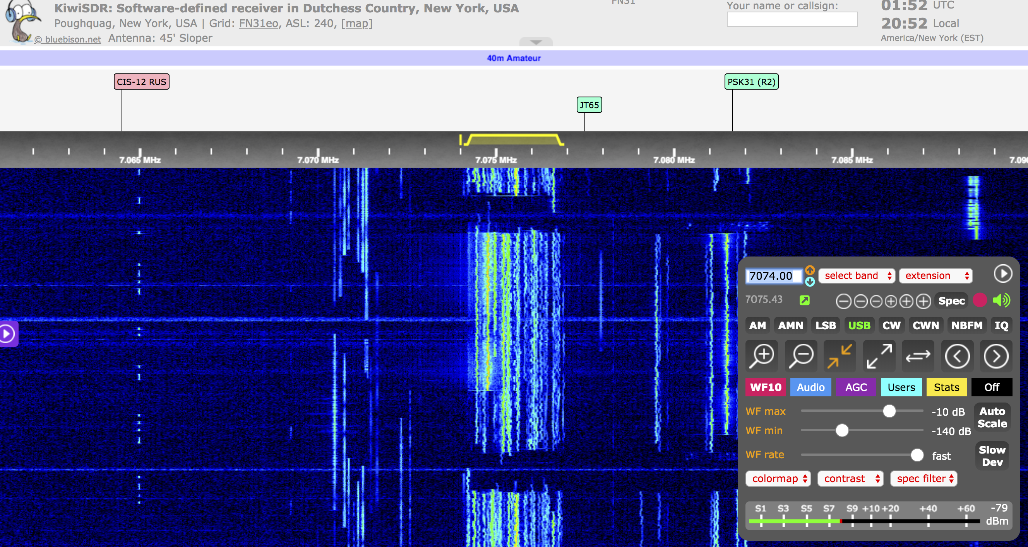
Both the WEBSDR project (websdr.org) and OPENWebRX (kiwisdr.com) work with Raspberry pi hardware for simple single-band remote SDR using RTL-SDR dongles, or other simple SDR hardware
Remote SDR

Slide 32
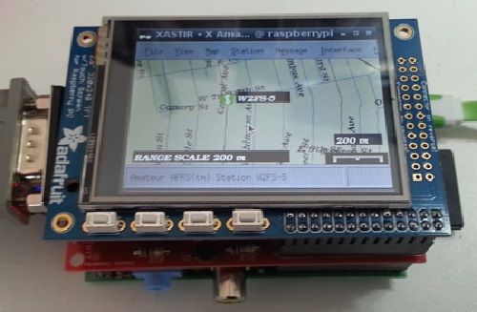
TNC-Pi is a special version of TNC-X designed to interface directly with the Raspberry Pi computer. It can connect to the Pi either via the Pi's serial port, or via the I2C protocol.
APRS

Slide 33
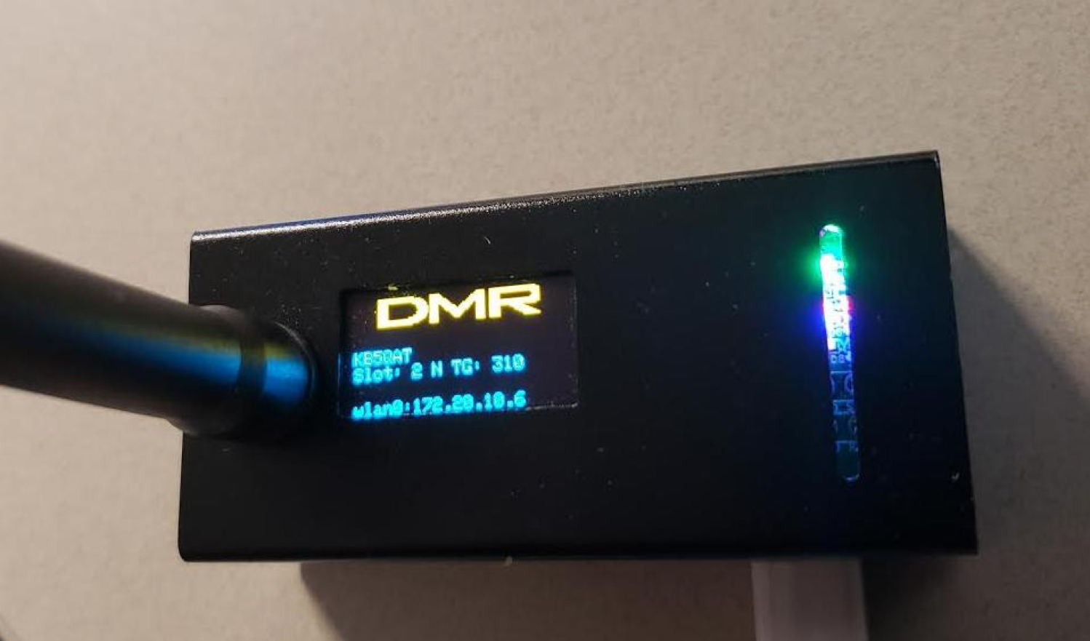
Make your own Digital Radio hotspot! You can order simplex and duplex add-on cards for a Raspberry Pi to turn it into a fully functioning D.R. hotspot running Pi-Star. This one was a kit and ran about $42 + a Raspberry Pi Zero W ($5) Works for all popular modes
Hotspots

Slide 34
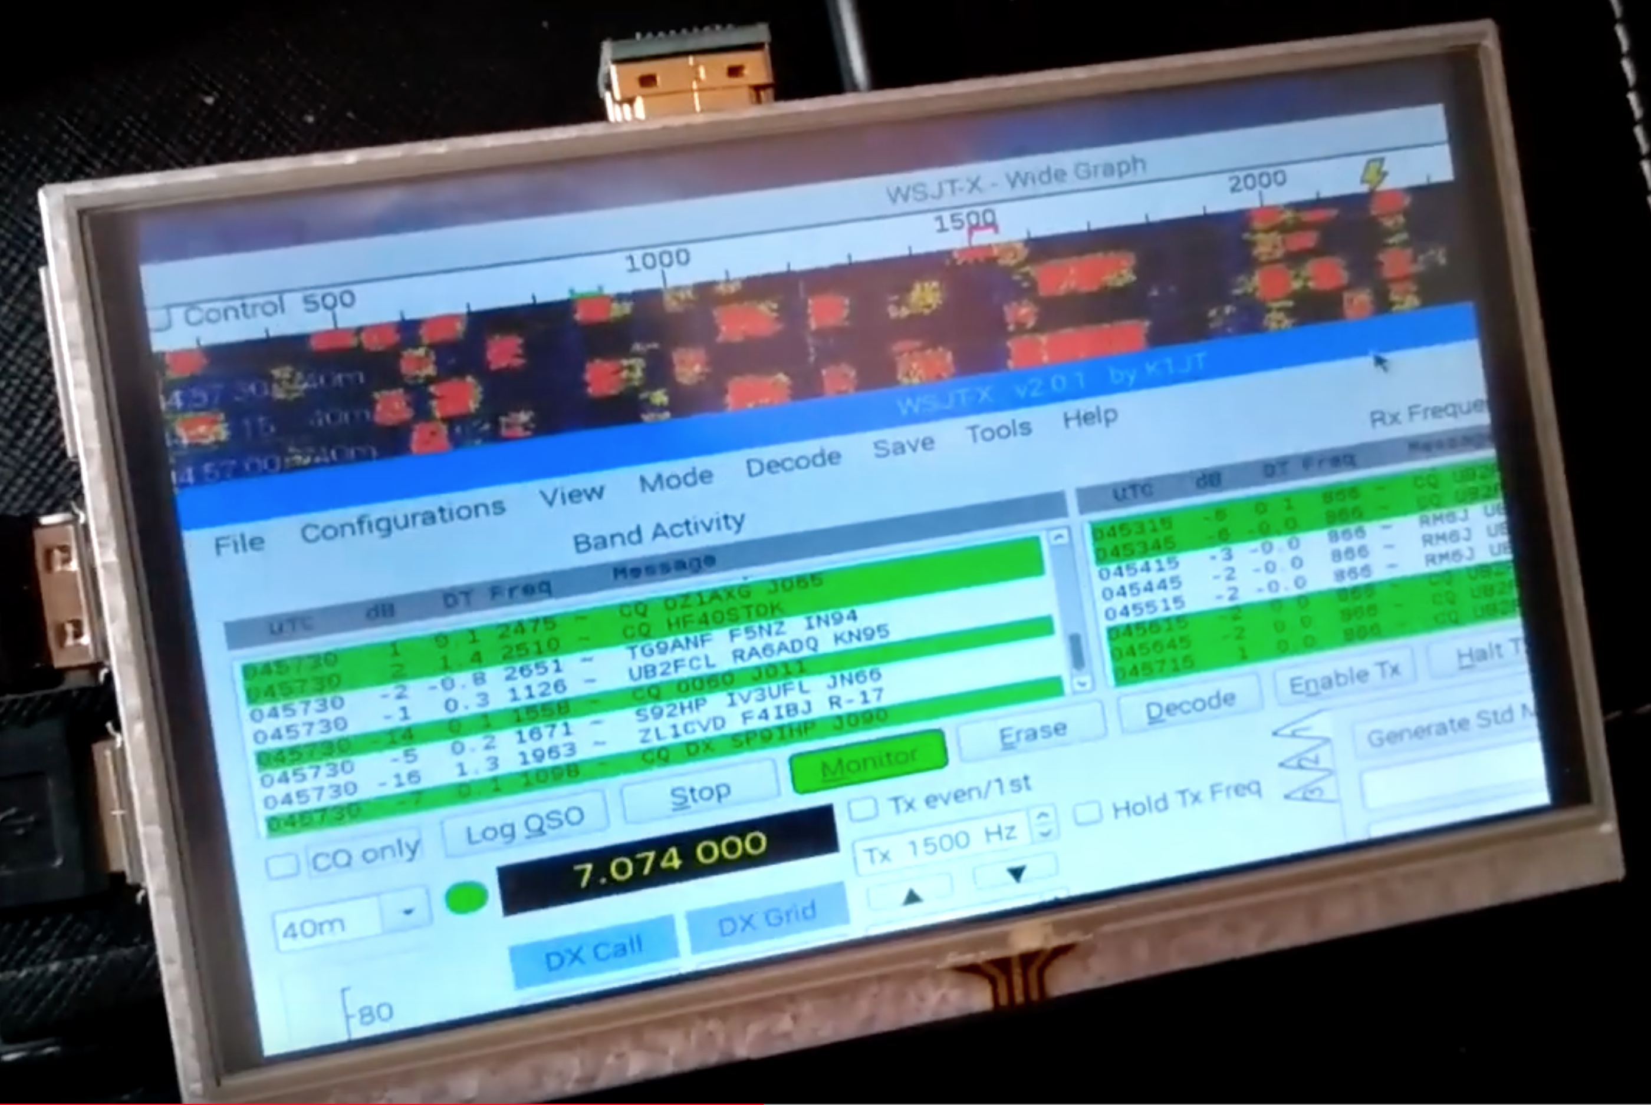
We now have enough speed from the Pi4 to create a reliable digital mode terminal.
Use a Pi4, and one of the new dedicated digital mode radios from QRPGuys, CRKits (Adam Rong), or Midnight Design Solutions
Digital Modes

Slide 35

There is a Groups.io group called Raspberry_Pi_4-Ham_RADIO
Just Googling “Raspberry Pi Ham Radio” will turn up mountains of information. Searching on Amazon brings up a couple of books on the subject
More Info

Slide 36
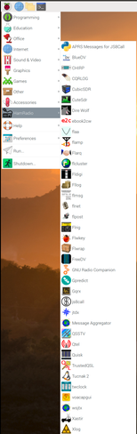
NEW!! W3DJS Has put together a Ham Radio Specific Raspberry Pi Image
Join the Groups.IO group Ham-Pi for more information
Also look at the io group Raspberry Pi for Ham Radio.
More Info

Slide 37





As usual I will post this set of slides on my website, as well as a list of links to resources by early next week.
FOFIO.BLOGSPOT.COM
OR
NEILGOLDSTEIN.COM and click on “FOFIO!”
HRU 2021
What’s Your Message?

