Slide 1
Introduction to AllStar
Dave Schmidt AI6VX
Sept 16, 2022

Slide 2
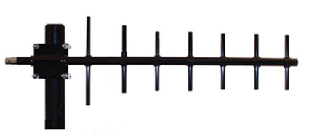
Repeater Linking - Analog
Analog
Co-located repeaters using physical cables between them
Separated repeaters with an analog RF link
Repeater
ControllerMixer
Repeater
Repeater
RF Link
RF Link
Repeater

Slide 3
Repeater Linking - Digital
Digital (ROIP – Radio Over IP)
Generally uses the internet to connect repeaters but can be linked over a private network (AREDN* for example)
Internet or Private Network
Repeater
Digitizer
Digitizer
Repeater
*AREDN – Amateur Radio Emergency Data Network

Slide 4
Pros and Cons of Linking Over the Internet
Pros
Distance between repeaters is no longer an issue
Links managed easily
Multiple links could be made without additional hardware
Repeaters can be accessed without a radio
Cons
Internet linked repeaters become standalone when internet is down
Internet quality can cause audio problems (delays, dropped or garbled audio)

Slide 5
Multiple Digital Links via Internet
Examples: PAPA Systems, SBARC, WIN System
Digitizer
Repeater
Repeater
Digitizer
HotSpot
Digitizer
Repeater
HotSpot

Slide 6
What is AllStar ?
AllStar is a digital way to link 2 or more repeaters together
High quality audio, support many different codecs
Supports full duplex operation
Free, open source software
Uses inexpensive hardware (Raspberry Pi)
Extensive linking capability
Linking control is easily made via the radio or web page
Full repeater control built in
Repeater can be configured as open, closed or private

Slide 7
AllStar is Based on Asterisk
From Wikipedia:
Asterisk is a software implementation of a private branch exchange (PBX). In conjunction with suitable telephony hardware interfaces and network applications, Asterisk is used to establish and control telephone calls between telecommunication endpoints, such as customary telephone sets, destinations on the public switched telephone network (PSTN), and devices or services on voice over Internet Protocol (VoIP) networks.
Started in 1999, Asterisk has become a very popular, powerful PBX software
Asterisk is rich with features, supports many codecs

Slide 8
How Did AllStar Start ?
Jim Dixon WB6NIL (SK) and Steve Rodgers WA6ZFT wrote an extension to Asterisk to provide hardware control of repeaters
From https://wiki.allstarlink.org/wiki/ASLCorporate:History
“From its very onset, I saw that Asterisk was not only a good telephony switch, but also makes a good application implementation platform for virtually any telecommunication application that requires use of many of the things that Asterisk provides.”
“…. essentially provide an outlet of nearly 30 years of experience and frustration with repeater and remote base systems, in the form of designing a system essentially "the way I think a system should be.“” – Jim Dixon

Slide 9
Compared to Other Digital Linking Solutions
Echolink
Half duplex only
Lower audio quality
Not open source
Easy to use, but usually phone or PC based
Also app users cannot key up until the repeater drops the carrier
Personally I find the audio delays unbearable.
Bandwidth issues with too many connected users (K6TZ example)
IRLP
Not open source
Specialized hardware required
Originates from the radio only (no web access)
Limited linking capability

Slide 10
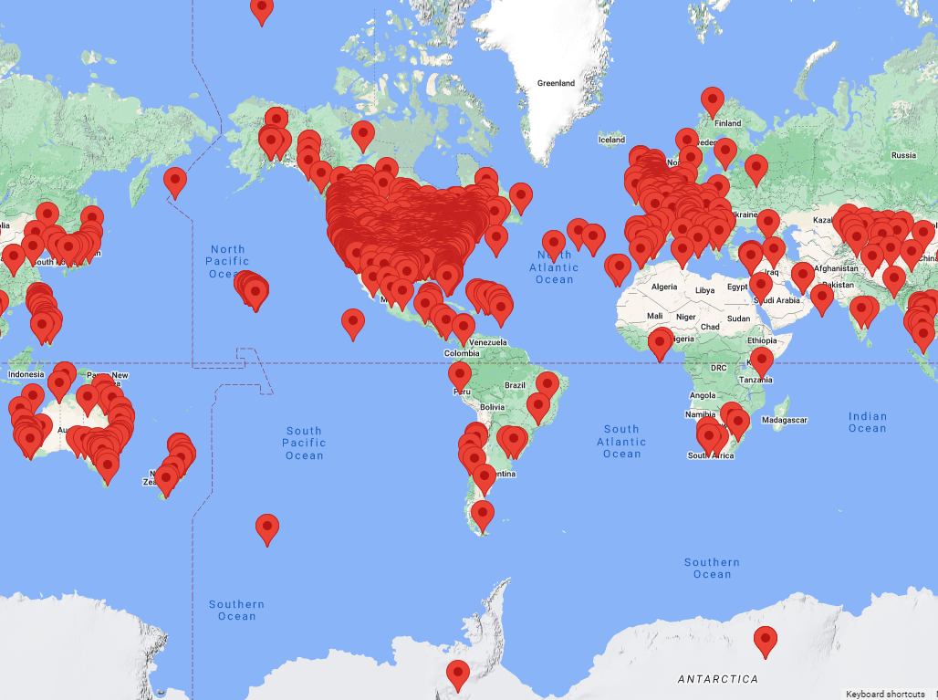
AllStar Nodes 26,000 Users, 25,000 Nodes

Slide 11
“Why Would I Care About AllStar?”
Use repeaters you cannot normally access
In a bad location? (me in Ventura) Want to talk to someone in another state or country?
Participate in nets or connect to hubs outside of your local repeaters
BlindHams, Hawaiian Hub, East Coast Reflector, Philadelphia Hub
Keep in touch with your local repeater when away from home
Just need an internet connection and it’s as if you’re home

Slide 12
AllStar vs DMR?
Similarities
Need to be connected to another source to be useful
Allow you to talk over great distances
Both have hotspots available – Self built and fully assembled.
AllStar Pros
Use radios you already have
Audio sounds better (it’s wide FM)
Personal nodes/hotspots have less issues
Possibly greater audience since it is analog FM at the repeater
DMR Pros
Designed to support groups
Communications are more network and group-centric.
Switching groups is simply changing your channel on the radio

Slide 13
AllStar Linking Examples – Small (Alaska Hub)

Slide 14
AllStar Linking Example – Big*
*Wednesday night WIN system net, was 130+ connected nodes

Slide 15
AllStar End User Access – Essentially 2 ways
Local Analog FM Repeater
Accessible and ‘Open’ (Configurable)
Use the radio you have and control the repeater using DTMF tones.
Use a hotspot connected to the internet
Radio-less version
RF version
Choose simplex or Duplex
All use Raspberry Pi and most solutions use the CM108 USB Soundcard

Slide 16
AllStar Access – Local AllStar Capable Repeater
Repeater RF Accessible and ‘Open’ (Configurable)
Use the radio you have and control the repeater using DTMF tones.
Example using SBARC’s 446.400 AllStar Repeater
*2 + AllStarLink node = Connect AllStar Link in monitor-only mode
*3 + AllStarLink node = Connect AllStar Link in transcieve mode
*1 + AllStarLink node = Disconnect AllStarLink
*10 = Disconnect most recent AllStarLink
*4 + node = Enter command mode on a remote node
*70 = Speak local connection status
*71 = Disconnect all links (AllStarLink)
[acknowledged by two short beeps]

Slide 17
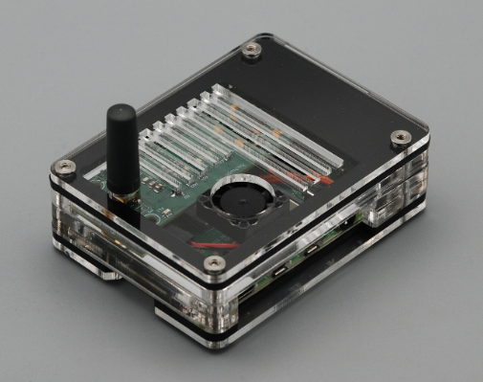
AllStar Access - Fully Built Hotspot - $$$
Really only 1 option - ClearNode https://www.node-ventures.com/ ~$350
Built in RF radio
Custom App uses AWS for coordination
Can be operated wired or wireless to Internet
Affected by Raspberry Pi shortages
Support can be delayed/difficult

Slide 18
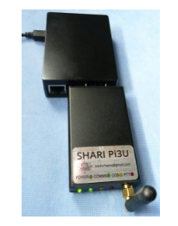
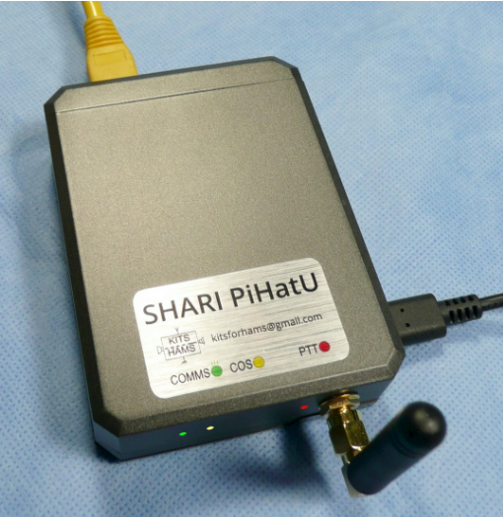
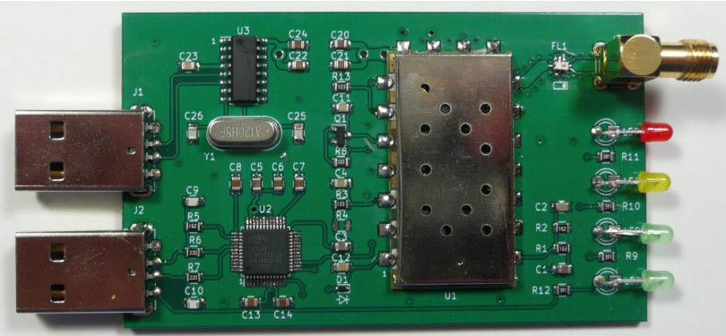
Personal AllStar Node – Partial Kits - $-$$
Best selection from Ham Projects https://hamprojects.info/
Adapters for a ‘bring your own transceiver’ node/repeater
Self contained RF based nodes ($65-$80)
You supply the Raspberry Pi (in short supply BTW)

Slide 19
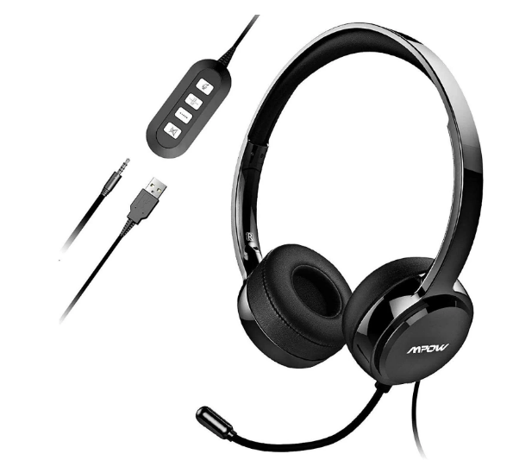
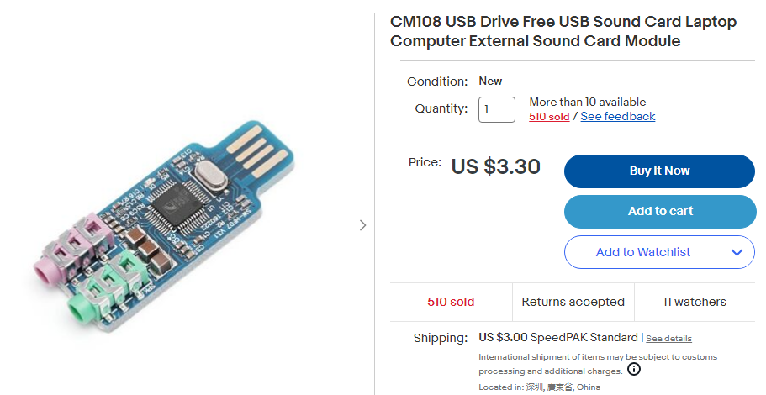
AllStar Node From ‘Scratch’ - $ (all need a Raspberry Pi)
Radio-Less (Full Duplex) – at least two options
Very specific USB Headphones ($10)
USB Sound Card + Mic and Headphones ($6)
Radio Based Half Duplex
USB Sound Card + single HT ($6 + HT price)
Radio Based Full Duplex
USB Sound Card + 2 HTs ($7 + 2 HTs)

Slide 20
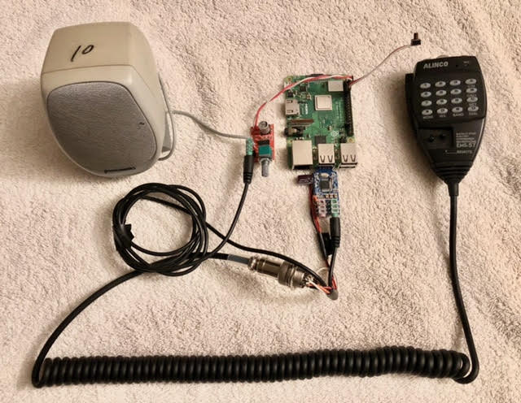
AI6VX Radio-less node #1 (first node built)
CM108 USB sound card, mobile transceiver mic, Rpi 3B+, 5V audio amplifier and a thrift store PC speaker
Learned DTMF decoding from the MIC was not reliable

Slide 21
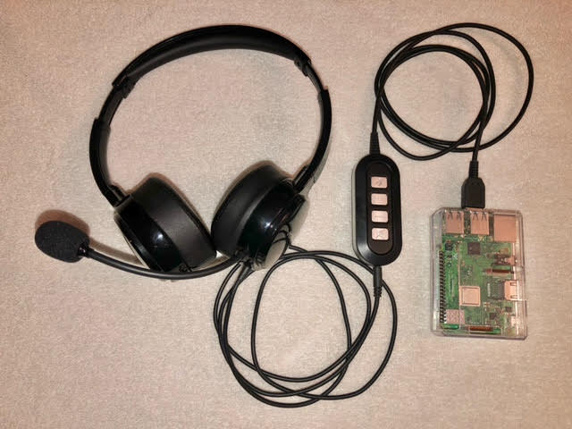
AI6VX Radio-Less Node #2
Uses a USB headset that contains the CM108 chip
PTT is the Volume ‘-’ button. All other buttons do nothing (?)

Slide 22
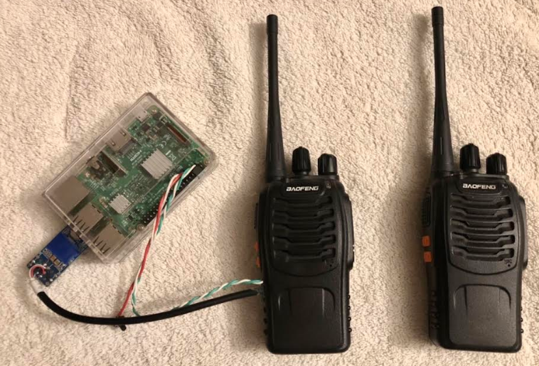
AI6VX Radio Based Node
CM108 USB sound card, Rpi 3B+, pair of Baofeng 888s HT’s
Final PA on HT removed to reduce transmitting power

Slide 23
Creating Your Own AllStar Personal Node
Buy your parts! (Pi’s in short supply)
Modify USB soundcard if needed
Register for an AllStar number at https://www.allstarlink.org/portal/register.php
Download HamVoip* or AllStarLink software and write to microSD card
Boot Pi from microSD card, configure your account settings
Adjust software settings for COS (carrier detect) and PTT (push to talk)
Adjust USB sound levels for your hardware
Enable AllMon/ Supermon if you want to control your device from a webpage or app
Connect to the internet
That’s it!
*All my nodes are Hamvoip based

Slide 24
Getting Your AllStar Number – AllStarLink.org

Slide 25
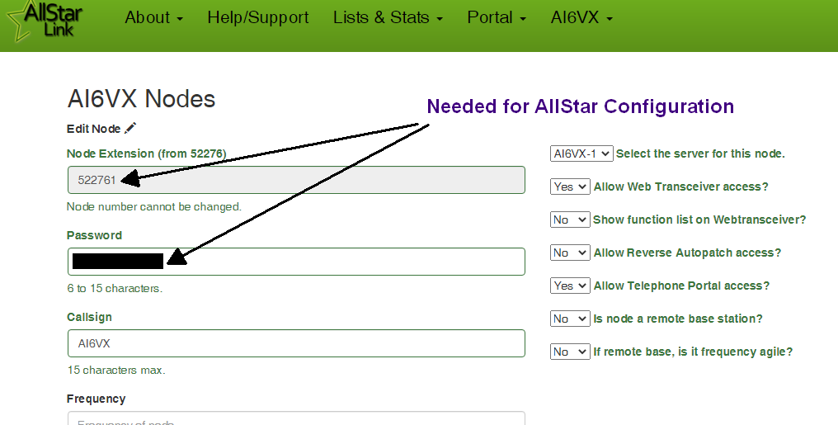
Getting Your AllStar Details

Slide 26
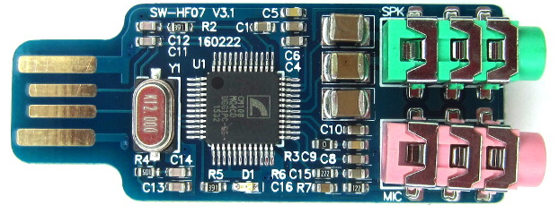
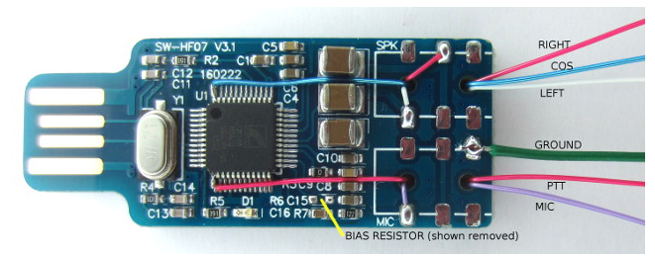
CM108 Modification
Bring out GPIO pins for PTT and carrier detect
Add transistor to key up the PTT on an HT or mobile transceiver
Add resistors for audio input and output level adjust
Before
Not my photos
After

Slide 27
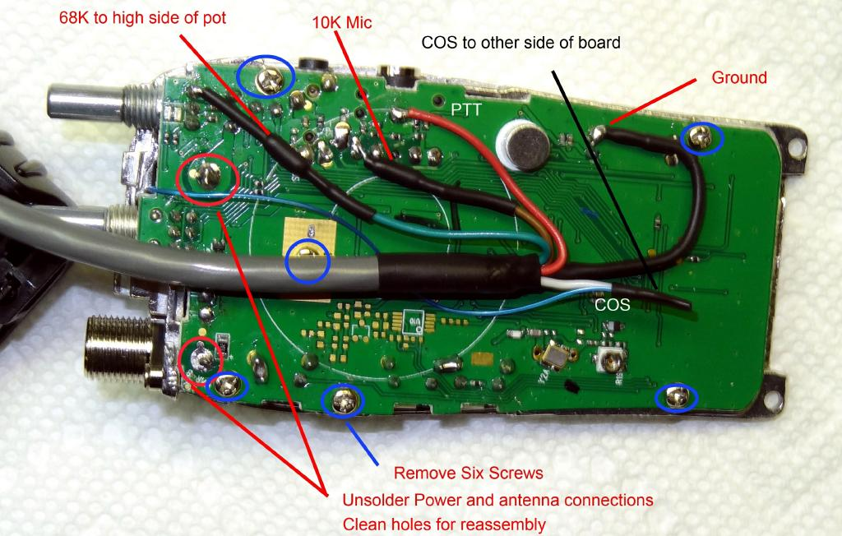
Baofeng 888s Modification
Open and tap into Mic, Speaker, PTT, Carrier Detect
Remove final PA for lower transmit power if desired.
Not my photo

Slide 28
Controlling Your Self-Built AllStar Personal Node
Use DTMF Signaling from Mic
Poor success for me
Use Allmon/Supermon
Web Based Configuration
Need to know your IP address
Use a cellphone app
I use Node Remote
Need to know your IP address

Slide 29
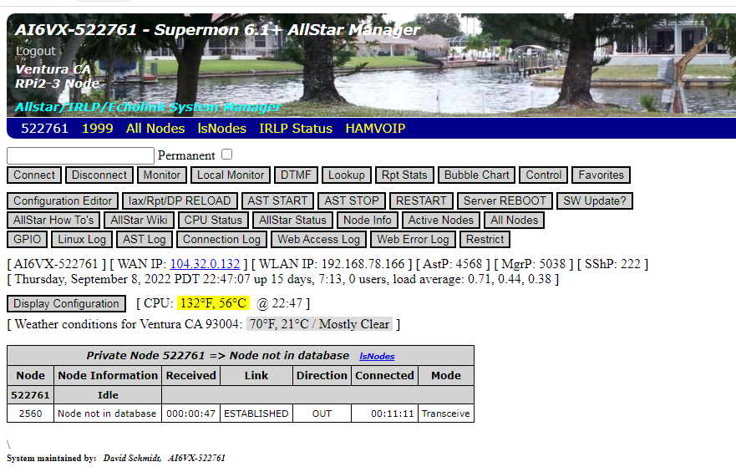
Webpage Control of Your Node

Slide 30
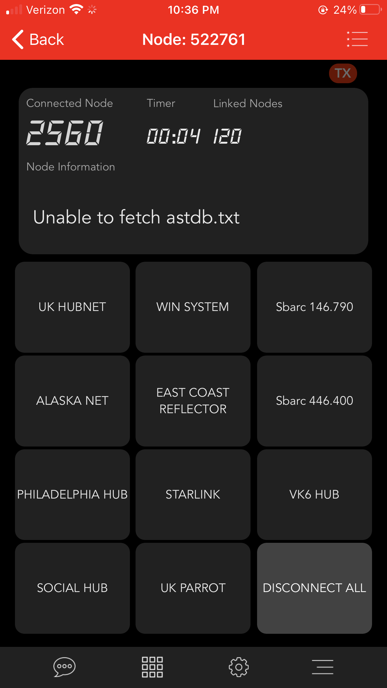
Phone App Control - Node Remote – iOS Example

Slide 31
Common Questions/Points of Confusion
Do I want a UHF or VHF ClearNode/Shari/DIY node? Does it need to match the repeater I am connecting to?
No. The RF link is between your HT in your house and your node. It doesn’t matter what AllStar repeater you are connecting to. UHF is preferred due to the larger number of clear frequencies.
Should I run a PL tone on my radio based node?
Yes – you do not want to key up into the connected Allstar node with RF noise
Does my PL tone on my node need to match the input of the repeater I am connecting to?
No. Your nodes PL is just to prevent random RF noise from transmitting into the network.
Can I travel anywhere and connect back to K6TZ?
Yes, with a reliable internet connection. Also for a DIY setup, you’ll need to be able to find the IP address of your node to be able to sent connect commands. DTMF tones over your HT may be more successful.

Slide 32
Summary
It’s useful for getting to non-local repeaters, hubs, that support AllStar
Very good sound quality, and most importantly, “It feels like analog FM”
Low cost barrier for entry. Rpi + $10 headphones and you’re in
Many options to play with (Radio-less, simplex, duplex)

Slide 33
Resources
AllStarLink https://www.allstarlink.org/
Register for AllStar #, Pi image if you want to use AllStarLink based SW
HamVoip https://hamvoip.org/
Source for HamVoip based Pi image
ClearNode https://www.node-ventures.com/buy-clearnode/
Maker and seller for fully assembled ClearNode AllStar node
HamProjects https://hamprojects.info/
Source for partial AllStar Kits (bring your own Pi, HT)
Also a good source for how to configure HamVoip
AllStar Setup https://allstarsetup.com/
Modifying CM108 USB Sound Card
Modifying Baofeng 888
Configuring AllStar
Enabling Allmon/Supermon
One source of USB Headphones – Mpow 071 https://www.amazon.com/dp/B0B87VMVRW

